Slide 1

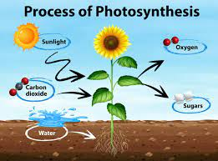
Biology for Engineers
21BE45 Photosynthesis
Ms. Supreetha K
Assistant Professor
Department of Biotechnology
Dayananda Sagar College of Engineering
Bangalore
supreetha-bt@dayanandasagar.edu
9916315305

Slide 2
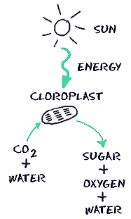
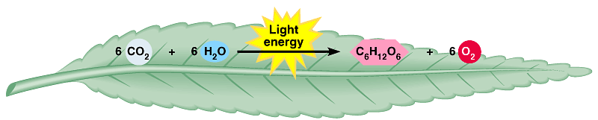
Biology for Engineers
Nature-bioinspired materials and mechanisms
Photosynthesis
What is Photosynthesis?
Photosynthesis is a process used by plants and other organisms to convert light energy into chemical energy.
In simple terms, Photosynthesis is the process by which plants use sunlight, water, and carbon dioxide to create oxygen and energy in the form of sugar.

Slide 3
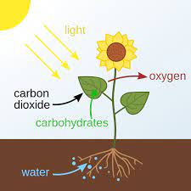
Biology for Engineers
Nature-bioinspired materials and mechanisms
Photosynthesis
Photosynthesis has 3 major events:
Sunlight is converted into chemical energy
Water (H₂O) is split into oxygen (O₂)
Carbon dioxide (CO₂) is fixed into sugars (C₆H₁₂O₆)

Slide 4
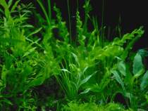
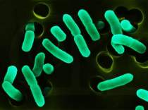

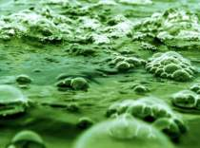
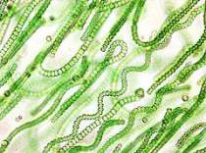
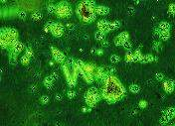
Biology for Engineers
Nature-bioinspired materials and mechanisms
Photosynthesis
Photosynthesis is carried out by:
These organisms are known as photoautotrophs or producers meaning they make their own food and energy from the sun.
Plants
Some bacteria
Plant Chef
My masterpiece!
Glucose
Algae
Cyanobacteria
Phytoplankton

Slide 5
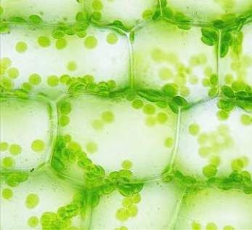
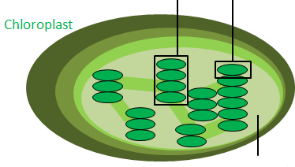
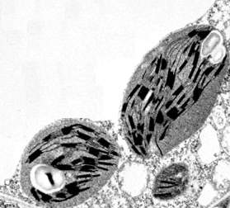
Biology for Engineers
Nature-bioinspired materials and mechanisms
Photosynthesis
Where Photosynthesis occurs?
Through evolution, plant cells, certain bacteria and some algae have acquired chloroplasts to help carry out the photosynthetic reaction.
Chloroplasts are also known as plastids, is a plant cell organelle.
Chloroplasts are full of round flattened discs called thylakoids.
Both pictures are of chloroplasts in plant cells at different magnifications
A stack of thylakoids is called a granum
Stroma is the space inside chloroplasts

Slide 6
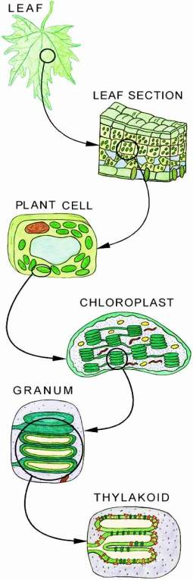
Biology for Engineers
Nature-bioinspired materials and mechanisms
Photosynthesis
The thylakoid membranes are lined by pigments such as chlorophyll and cartenoids.
Chlorophyll is a green pigment and is the most abundant.
Chlorophyll absorbs all wavelength colors except green, which is reflected off giving plants their green appearance.
These pigments harvest light energy packets or photons when they absorb sunlight.

Slide 7
Biology for Engineers
Nature-bioinspired materials and mechanisms
Photosynthesis
The Photosynthesis Reaction is divided into two parts:
Light Reaction
Dark Reaction
Light reactions or light dependent reactions.
It capture light energy to power photosynthesis.
Light reactions occur during the day time.
They take place in the thylakoids.
Pigments in the thylakoid membranes form protein complexes called Photosystem I and Photosystem II.
These photosystems harvest photons to charge up energy carrying molecules that will power the dark reactions.
Dark reactions or light independent reactions.
It do not need light energy to power their reactions and can occur day or night.
Dark reactions occur in the stroma of chloroplasts (the space that surrounds thylakoids) and fix carbon dioxide into glucose.

Slide 8
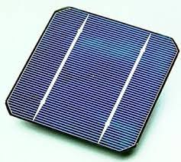
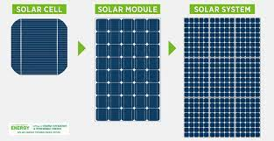
Biology for Engineers
Nature-bioinspired materials and mechanisms
Photosynthesis
Photovoltaic cells
A solar cell, or photovoltaic cell, is an electronic device that converts the energy of light directly into electricity.
1. How do solar cells work?
A solar panel works by allowing particles of light, or photons, to knock electrons free from atoms, generating a flow of electricity.
2. What is the principle of solar cells?
Silicon crystals are laminated into p-type and n-type layers, stacked on top of each other. Light striking the crystals induces the “photovoltaic effect,” which generates electricity.
3. What does the solar cell include?
Solar cell consists of a crystalline silicon solar panel which is a series of interconnected silicon cells joined together to form a circuit.
4. Can solar power from photovoltaic cells be harnessed in the absence of sunlight?
No, it can be only harnessed in the presence of sunlight.

Slide 9
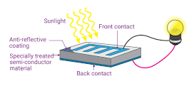
Biology for Engineers
Nature-bioinspired materials and mechanisms
Photosynthesis
Photovoltaic cells
Photovoltaic cells consist of two or more layers of semiconductors (silicon) with one layer containing positive charge and the other negative charge lined adjacent to each other.
Sunlight, consisting of small packets of energy termed as photons, strikes the cell, where it is either reflected, transmitted or absorbed.
When the photons are absorbed by the negative layer of the photovoltaic cell, the energy of the photon gets transferred to an electron in an atom of the cell.
With the increase in energy, the electron escapes the outer shell of the atom.
The freed electron naturally migrates to the positive layer creating a potential difference between the positive and the negative layer. When the two layers are connected to an external circuit, the electron flows through the circuit, creating a current.

Slide 10
Biology for Engineers
Nature-bioinspired materials and mechanisms
Photosynthesis
Advantages of Photovoltaic cells
Environmental Sustainability: Photovoltaic cells generate clean and green energy as no harmful gases such as CO_{x}, NO_{x} etc are emitted.
Economically Viable: The operation and maintenance costs of cells are very low.
Accessible: Solar panels are easy to set up and can be made accessible in remote locations or sparsely inhabited areas at a lesser cost as compared to conventional transmission lines.
Renewable: Solar energy is renewable and abundant in nature
Cost: Solar panels have no mechanically moving parts except in some highly advanced sunlight tracking mechanical bases.
Cost effective maintenance

Slide 11
Algal based Bio-solar panels
Algae can be potential used to boost silicon solar module efficiency by 4% and thin film by 36%.
The algae materials are added to the encapsulant in silicon-based modules or to the anti-reflective coating on the glass of thin film modules.
The team cultivates single-celled photosynthesizing algae called diatoms to extract their shells, which reportedly have unique light-manipulating properties, including blocking ultraviolet (UV) light.
The diatom shells are added to the encapsulant of silicon modules or to the anti-reflective coating on the glass of thin film modules, which could boost their efficiency by 4% and 36%, respectively

Slide 12
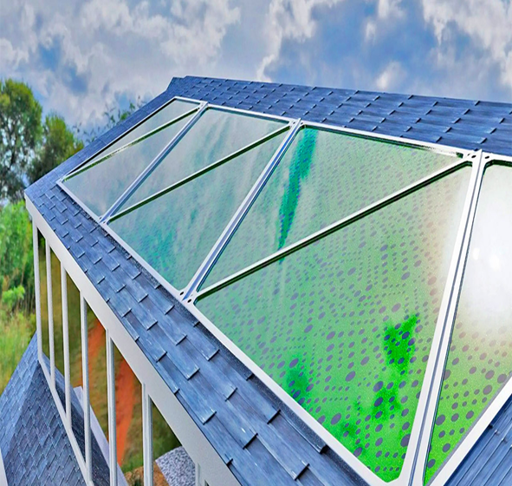
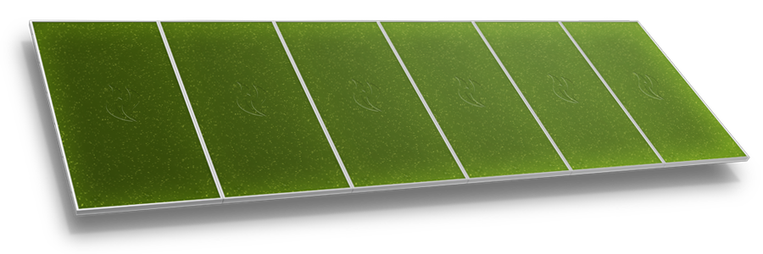
Algal based solar panels

Slide 13
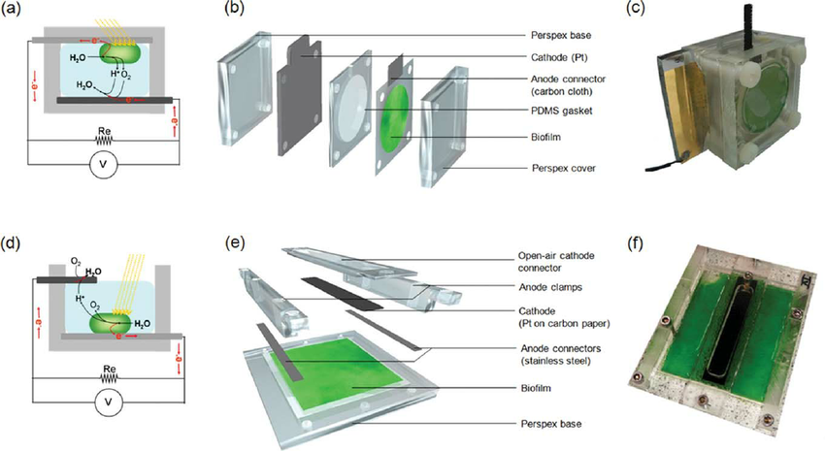
Bio-photovoltaic cells

Slide 14
Biology for Engineers
Nature-bioinspired materials and mechanisms
Photosynthesis
Disadvantages of Photovoltaic cells
The efficiency of solar panels is low compared to other renewable sources of energy.
Energy from the sun is intermittent and unpredictable and can only be harnessed in the presence of sunlight. Also, the power generated gets reduced during cloudy weather.
Long-range transmission of solar energy is inefficient and difficult to carry. The current produced is DC in nature and the conversion of DC current to AC current involves the use of additional equipment such as inverters.
Photovoltaic panels are fragile and can be damaged relatively easily. Additional insurance costs are required to ensure a safeguard of the investments.

Slide 15
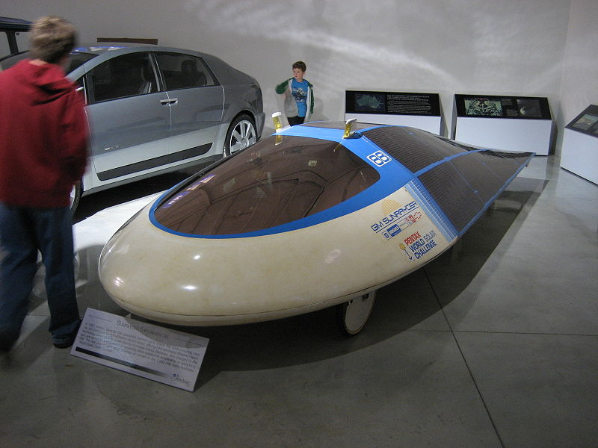
Biology for Engineers
Nature-bioinspired materials and mechanisms
Photosynthesis
Applications of Photovoltaic cells
Vehicular applications
Application of solar cells as an alternative energy source for vehicular applications is a growing industry.
Electric vehicles that operate off of solar energy and/or sunlight are commonly referred to as solar cars.
These vehicles use solar panels to convert absorbed light into electrical energy that is then stored in batteries.
Batteries in solar-powered vehicles differ from those in standard ICE cars because they are fashioned in a way to impart more power towards the electrical components of the vehicle for a longer duration.
The first instance of photovoltaic cells within vehicular applications was around midway through the second half of the 1900's.
Sunraycer vehicle by General Motors that achieved speeds of over 40 mph.

Slide 16
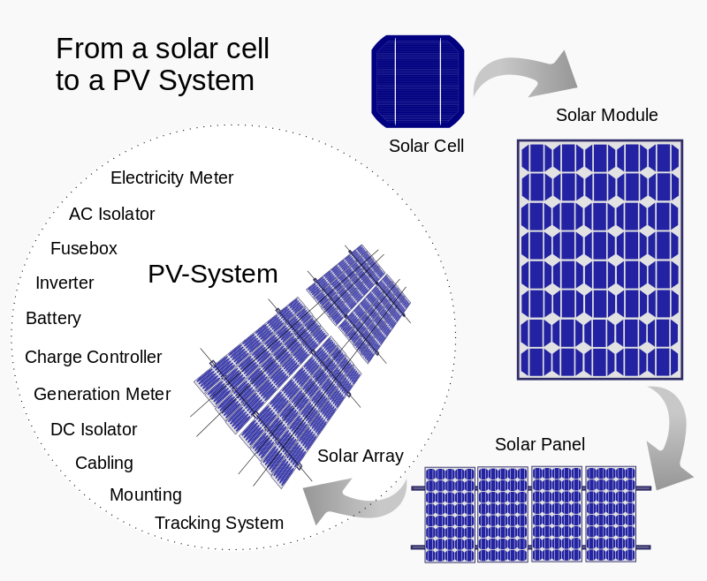
Biology for Engineers
Nature-bioinspired materials and mechanisms
Photosynthesis
Applications of Photovoltaic cells
Cells, modules, panels and systems
Multiple solar cells in an integrated group, all oriented in one plane, constitute a solar photovoltaic panel or module. Photovoltaic modules often have a sheet of glass on the sun-facing side, allowing light to pass while protecting the semiconductor wafers. Solar cells are usually connected in series creating additive voltage. Connecting cells in parallel yields a higher current.
Although modules can be interconnected to create an array with the desired peak DC voltage and loading current capacity, which can be done with or without using independent MPPTs (maximum power point trackers) or, specific to each module, with or without module level power electronic (MLPE) units such as microinverters or DC-DC optimizers. Shunt diodes can reduce shadowing power loss in arrays with series/parallel connected cells.

Slide 17
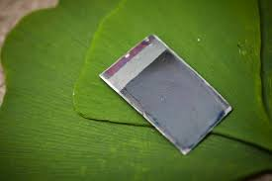
Biology for Engineers
Nature-bioinspired materials and mechanisms
Photosynthesis
Bionic Leaf
The Bionic Leaf is a biomimetic system that gathers solar energy via photovoltaic cells that can be stored or used in a number of different functions.
Bionic leaves can be composed of both synthetic (metals, ceramics, polymers, etc.) and organic materials (bacteria), or solely made of synthetic materials.
The Bionic Leaf has the potential to be implemented in communities, such as urbanized areas to provide clean air as well as providing needed clean energy.
In 2009, first developed the "artificial leaf", a device made from silicon and an anode electrocatalyst for the oxidation of water, capable of splitting water into hydrogen and oxygen gases.

Slide 18
In natural photosynthesis, photosynthetic organisms produce energy-rich organic molecules from water and carbon dioxide by using solar radiation.
The process of photosynthesis removes carbon dioxide a greenhouse gas from the air.
Artificial photosynthesis, as performed by the Bionic Leaf, is approximately 10 times more efficient than natural photosynthesis.
Using a catalyst, the Bionic Leaf can remove excess carbon dioxide in the air and convert that to useful alcohol fuels, like isopropanol

Slide 19
The bionic leaf is an artificial leaf, which efficiently splits water into hydrogen and oxygen gas by pairing silicon — the material that makes up solar panels
The hydrogen gas can be stored on site .
Biology at Harvard Medical School, to explore their device uses a photovoltaic panel to split the water into oxygen and hydrogen and then feeds the hydrogen to the microbes, which convert CO2 from the air into fuels such as alcohol.
The first version of the device, which debuted in 2015, was able to produce just over 200 milligrams of fuel per liter of water new uses for the technology.

Slide 20
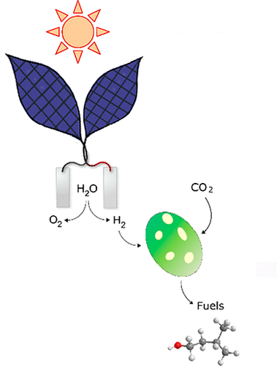
Bionic leaf
Artificial leaf
{Bionic leaf)
Bionic leaf can be
considered as
Photovoltaic cells to
split water
Hydrogen using bacteria

